Slide 1

Major Project IA -2 Master of Science in Computer Science IV Semester – 2023
School of Computer Science and Applications

Slide 2
A PROJECT REPORT ON Human Activity Recognition Using Deep Learning Models
Submitted IA-2 Project report completion of MSc
Presented by:
Mr./Ms. G Avinash
SRN: R21DG012
Internal Guide : Prof. Mohammed Mueen Pasha
External Guide : Ranjith Mohan

Slide 3
Agenda
Global Certification ( Attach soft copy certificate )
Internship Certificate
Project -Architecture diagram
Pseudo code
Implementation
Screen shots
Conclusion
Future Enhancement
Research Paper Details

Slide 4

1.Global certification

Slide 5
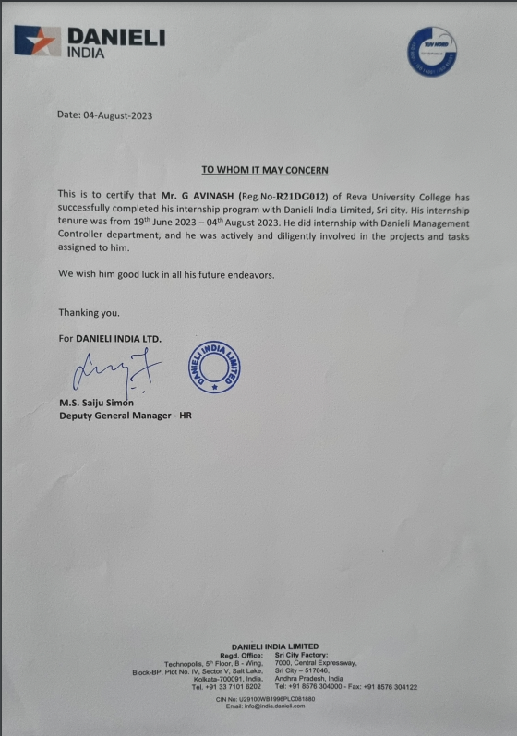
2.Internship certification

Slide 6
3.Architecture diagram
Data Set
Data Preprocessing
Model Training
LSTM
CON1D
Performance
Accuracy

Slide 7
4.Pseudo code
Initially taken a dataset of Human Activity.
Data Preprocessing has done for raw data set.
Splitted data set into test and training.
Used Long-Short-Term-Memory (LSTM) model and Convolutional Neural Network One Dimensional model (1D-CNN).
Models are trained using Human Activity data set.
Noted the accuracy and loss of the both models.
Done Grid search for hyper tuning the model for better accuracy.

Slide 8
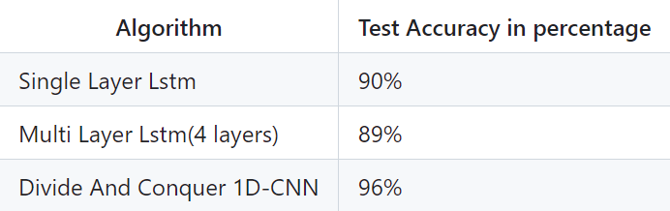
5.implimentation

Slide 9
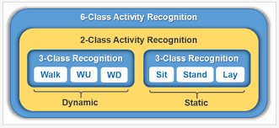
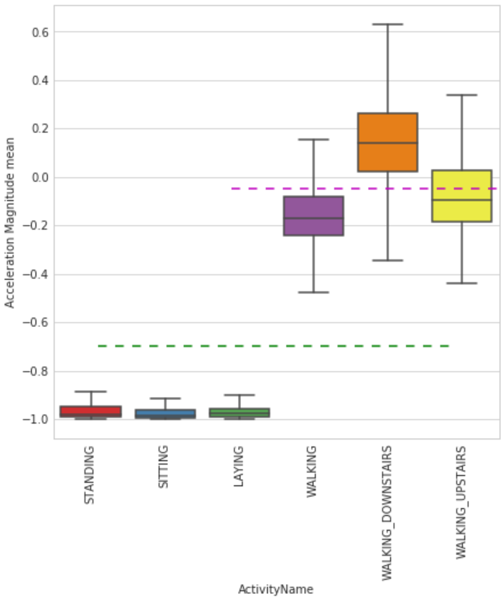
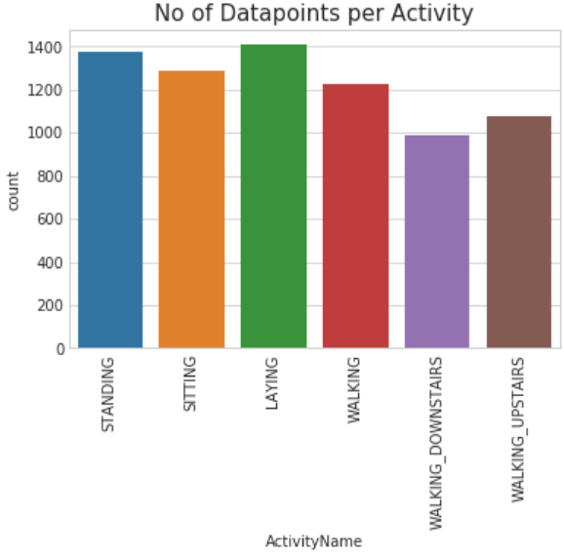
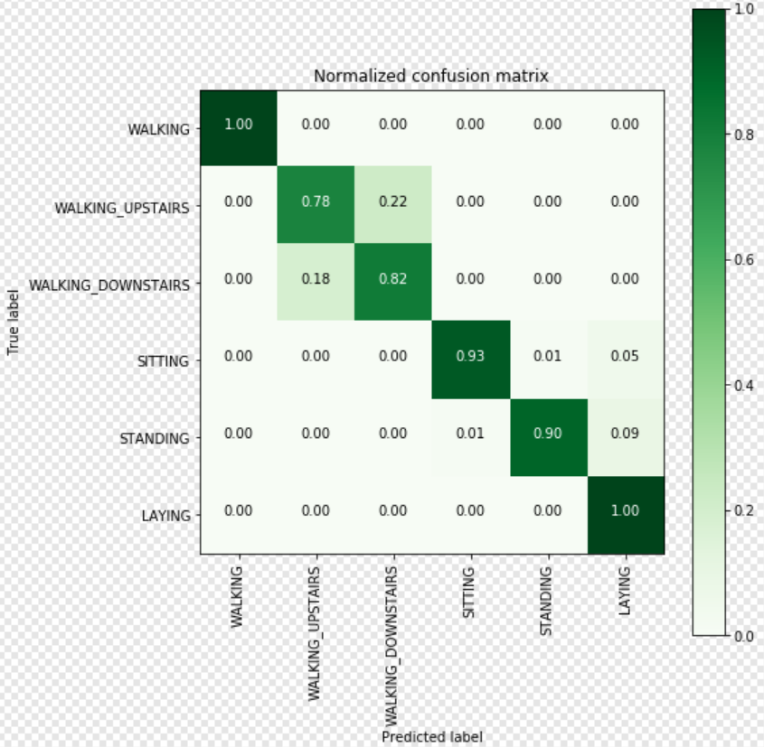
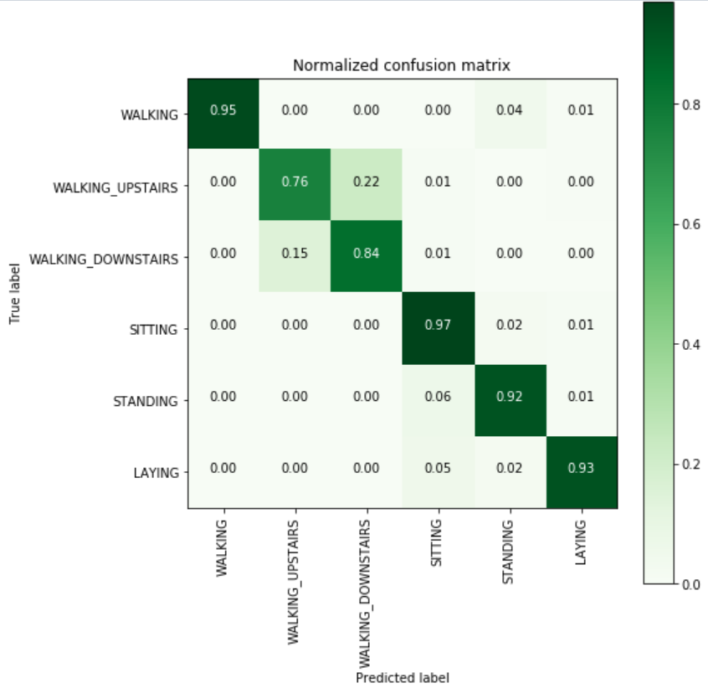
6.Screen shots

Slide 10
7.conclusion
In conclusion, the application of deep learning models to human activity recognition holds great promise in various domains, ranging from healthcare and sports to security and industrial settings. Through continuous research and innovation, these models have demonstrated significant advancements in accurately identifying and categorizing human activities from various data sources, such as video, audio, and sensor inputs.

Slide 11
8.Future enhancement
Spatio-Temporal Hierarchies
Long-Term Temporal Modelling
Few-Shot and Zero-Shot Learning
Self-Supervised Learning
Multi-Modal Learning
Long-Term Dependencies
Transfer Learning and Pre-training
Data Augmentation

Slide 12
9.Research paper
Title: Machine Learning Based Systematic Approach For Timely Detection Of Leukemia.
Paper ID: ICICTA-129
Publication Details: ICICTA-2023

Slide 13
Thank You

